Slide 1

Intro Project
DONE BY: Baygeldiev Samat/bekmurzaev elmir

Slide 2

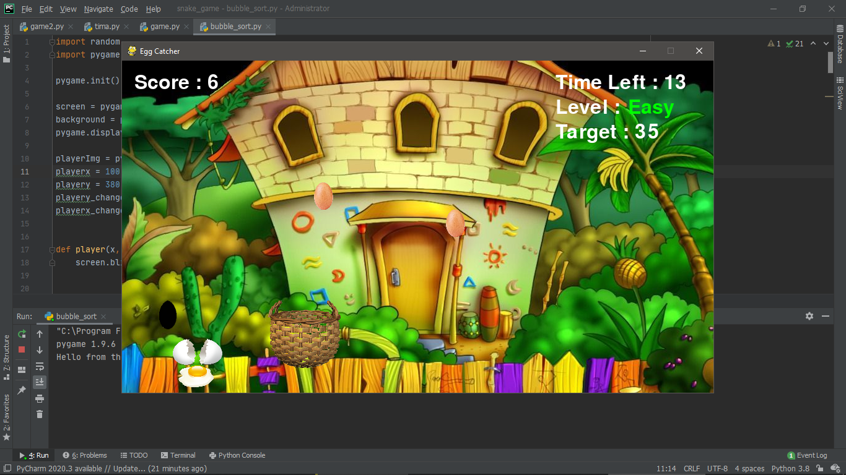
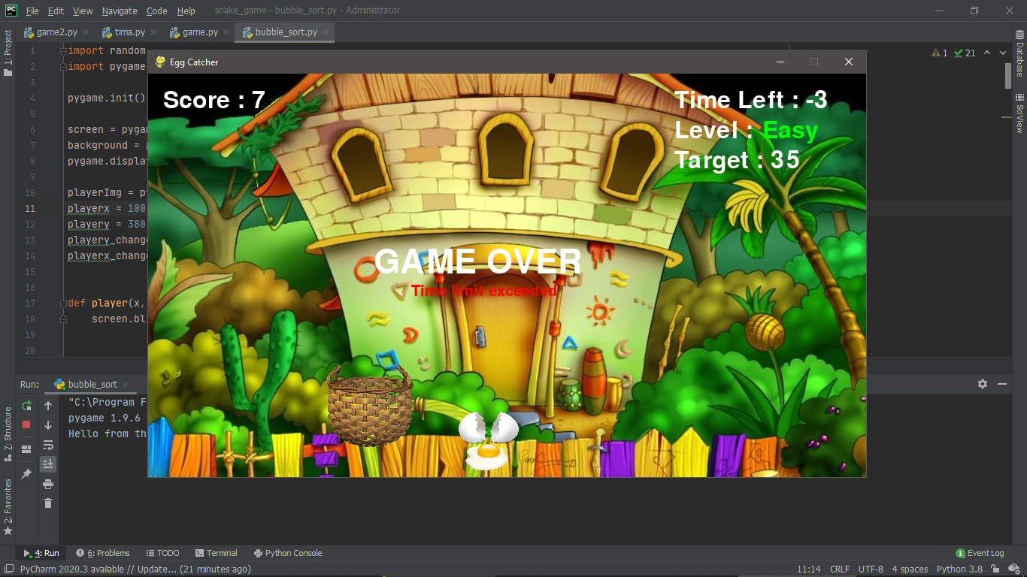
Egg catcher
This is the simple game “Egg catcher” based on python.
Rules:
1. you need to collect white and yellow eggs to bucket in limited time 30 seconds.
2. you need to dodge from black eggs. If you catch the black egg, the game will over.

Slide 3
In order to win the game , you need to collect 35 eggs in 30 sec.
Your can check your score on left-top of the screen

Slide 4

Instructions to the game
To the move the bucket press following buttons :
Move left “key left “
Move right “key right “
Pause: “key up “
Pause
Left
Right

Slide 5
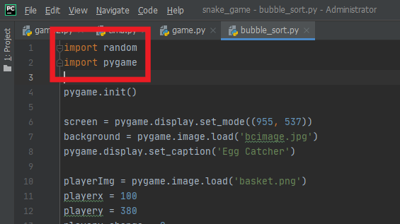


Libraries
We used just two libraries:
1.
2.

Slide 6
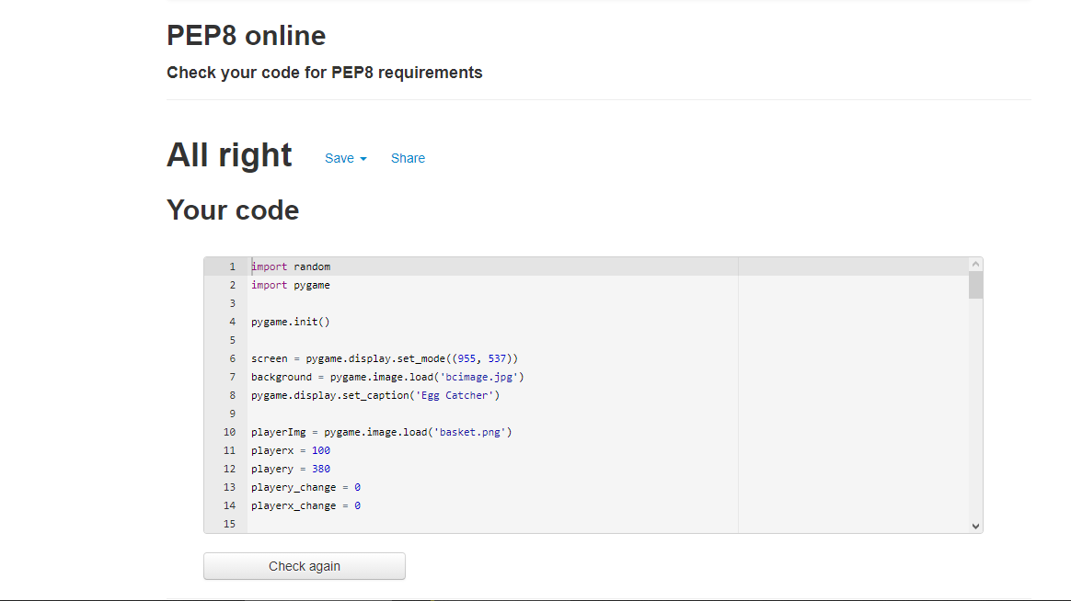

Design
Checked by : http://pep8online.com
https://github.com/DelaemIgrulki/Egg_catche

